Slide 1

Financial Markets Project Presentation
Prepared by :
Azza Karchoud Emna Megdiche Jihene Gazzeh Takoua Hmidi

Slide 2

OUTLINE
Post
_{Investment} Conclusion
Phase
Investment Phase
Strategy
Broker’s
5
Explanation
Choice
4
3
1
2

Slide 3


BROKER’S CHOICE
After conducting a comprehensive analysis of various brokers, the most suitable ones were :
1/ Tunisie Valeurs
stands out with its in-depth company analysis and insightful research .
We negotiated a reduction of fees from 0.8% to 0.5%.
2/ MAC SA
We opened an account with Mac SA for its lower fees (0.3%) compared to Tunisie Valeurs.

Slide 4

A TOP-DOWN STRATEGY
Sector Analysis
1
Company Analysis within Chosen Sectors
2
Choosing the Most Profitable Companies: (20 companies)
3
Finalizing Investment Decisions: (12 companies)
4

Slide 5

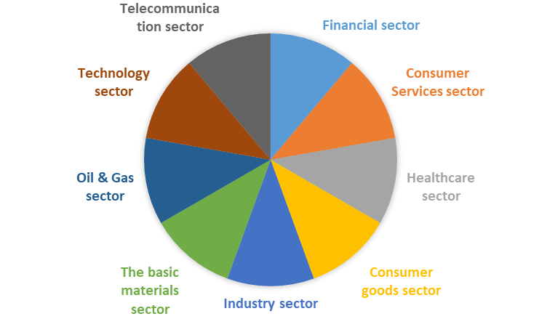
SECTOR’S ANALYSIS

Slide 6
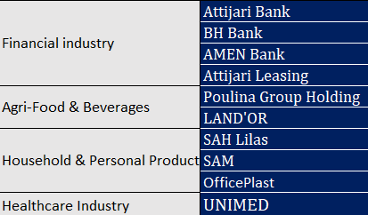
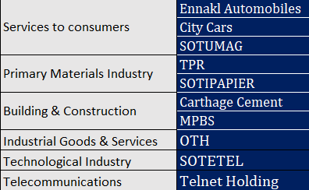
20 COMPANIES ANALYSIS
After conducting an exhaustive analysis of 58 listed companies, our assessment has led us to identify 20 standout entities. These selected companies have not only showcased inherent strength in their operations but have also exhibited promising future prospects which can lead to winning investment strategies .

Slide 7

Promising companies based on Technical Analysis
Attijari Leasing
Meuble Intérieurs SAM
Ennakl Automobiles
Carthage Cement- fluctuating
Attijari Bank
Poulina Group Holding- reserved opinion
& FSA
Amen Bank
Tunisie Profilés Aluminium (TPR) - risky
One Tech Holding
CITY CARS
SOTUMAG-Diversification
MPBS-fluctuating

Slide 8
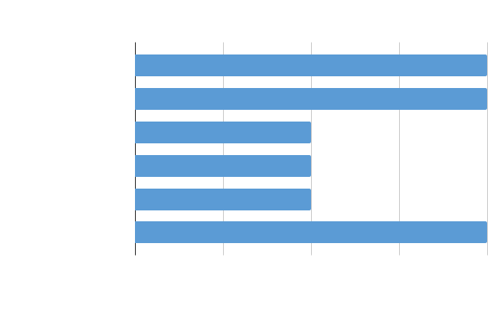
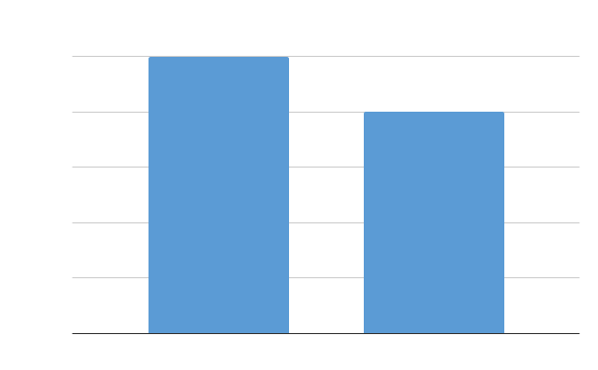
PORTFOLIO DIVERSIFICATION
-Our investment portfolio is characterized by a risk-oriented approach, exclusively comprising equity positions in nine companies spanning six diverse sectors .
-This allocation strategically incorporates four companies exhibiting an inverse correlation with the Tunindex, alongside five correlated entities, thereby reducing risk and ensuring a diversification strategy.

Slide 9
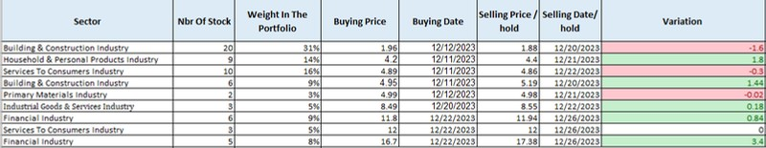

PORTFOLIO CONSTRUCTION
-The portfolio construction process was initiated through an iterative application of Markowitz's optimization model.
-With a budgetary limit of 200,000 TND, weights were assigned to each company based on their chronological appearance in the Markowitz optimization process and the weight provided by Markowitz for the first portfolio
-For the second portfolio, weights were assigned based on the most favorable company determined through FSA, SWOT, and technical analysis.

Slide 10
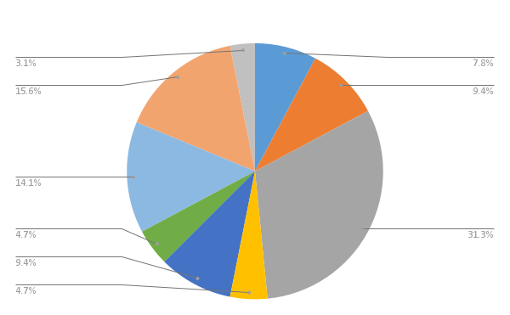
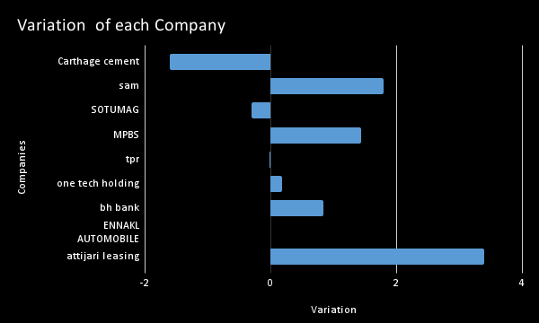
WHAT STOCKS TO BUY ?
-The primary focus of our investment strategy is centered on identifying undervalued stocks with future appreciation in month of December .
-Our decision-making process integrates strong buy indications from investing.com along with technical analysis, financial statements analysis (FSA), and macroeconomic factors (SWOT analysis).

Slide 11

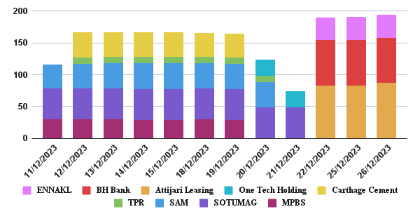
DAILY PORTFOLIO COMPOSITION

Slide 12
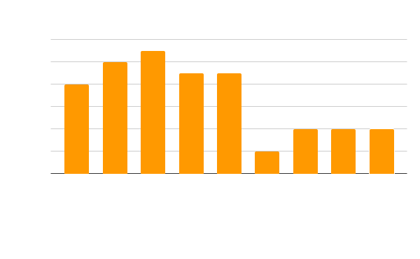

-The specified buying price range, ranging from TND 1.96 to 16.7, signifies a deliberate concentration on smaller and medium-sized companies.
-SOTUMAG leads with an 11-day holding period, followed by SAM at 10 days. TPR and MPBS share the third spot with a 9-day holding period each.
-This comprehensive portfolio construction
reflects a balanced strategy at the intersection of risk management, growth potential, and diligent analysis.

Slide 13

PORTFOLIO REVIEW (DEC 11-26)
First Portfolio (Dec 11-20):
On December 11, we initiated the investment phase, purchasing stocks of MPBS, SAM, and SOTUMAG based on technical analysis. On December 12, we added TPR and Carthage Cement to our portfolio using the same approach. Holding these stocks until December 20.
SAM stood out in the first portfolio, reaching a peak return of +6.7% on December 14 & 15 but later declining to +4%. Despite our overconfidence, we sold SAM on December 21 for a profit at 4.4, having bought it at 4.2.
Carthage Cement, however, proved to be the least successful investment, with its return dropping until we sold it for 1.88 per stock, having purchased it for 1.96.
Second Portfolio (Dec 22-26):
On December 22, we restructured our portfolio, acquiring Attijari Leasing, BH Bank, and Ennakl Automobiles based on technical analysis.
Attijari Leasing shone in the second portfolio, initially showing a negative return that improved on December 26, reaching +4.072% and yielding a revenue of 3.4dt.
On December 26, we placed limit sell orders on the stocks of the second portfolio.

Slide 14

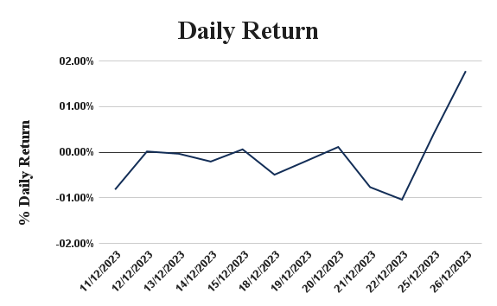
DAILY RETURN
Average Return (-0.10%):
The portfolio, on average, has lost a very small amount each day (approximately 0.10%). However, it's crucial to consider the variance to understand the variability of returns.
Standard Deviation (0.70%): This indicates significant fluctuation in daily returns. The actual returns have often deviated from the average return by about 0.70%, suggesting both gains and losses of varying magnitudes.

Slide 15

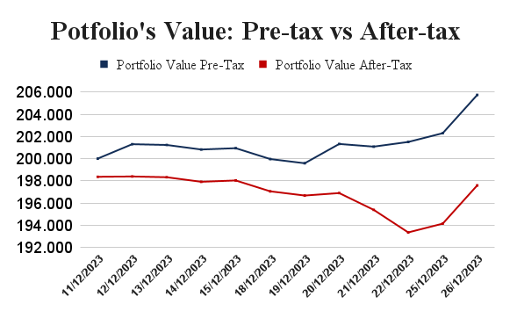
IMPACT OF TAXES ON PORTFOLIO’S VALUE
Average Return (Pre-tax) = + 0.26% Average Return (After-tax) = - 0.10%
Taxes have reduced the average return by approximately 0.36 percentage points (0.26% - (-0.10%)).
The after-tax return is negative, suggesting that taxes have eroded the investment's gains to the point of a slight loss.
This graph clearly demonstrates the drag taxes exert on our portfolio's value. The consistent gap between pre-tax value and after-tax value lines visually portrays the impact of capital gains taxes on realized profits. This impact is particularly evident in short-term holdings, highlighting the importance of tax-efficient strategies for optimal portfolio performance.

Slide 16

MONEY WEIGHTED RETURN
It’s applied for portfolios that are :
1
Actively managed
2
Managed on a short-term horizon , i.e , have short-term goals
3
Flexible in terms of decision-making
4
Assessed in real-world context
MWR = 4.134% : the portfolio has overperformed during the investment period

Slide 17
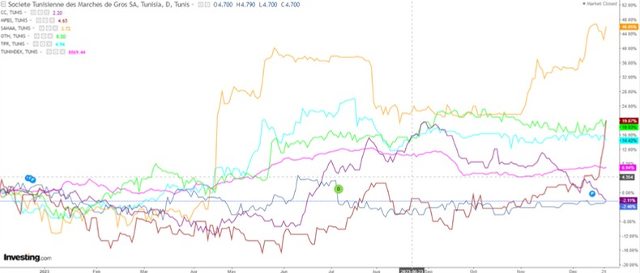
BENCHMARK COMPARISON
1. To Tunindex 1stPortfolio
The benchmark analysis showed that SAM, OTH, TPR, and MPBS have outperformed Tunindex, while CC and SOTUMAG underperformed it during the month of December.

Slide 18
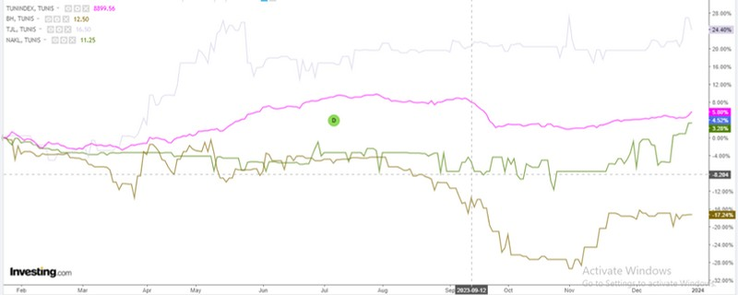
2nd Portfolio
Only Attijari Leasing outperformed market by 26/12/2023

Slide 19

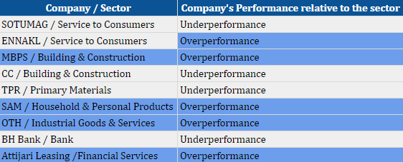
2. To Sectors

Slide 20

RATIOS ANALYSIS
A stock portfolio with a beta of approximately 0 suggests that the portfolio's returns are not expected to be strongly correlated with the overall market , i.e , changes in the market are not expected to have a significant impact on the portfolio's returns.
The portfolio is expected to be relatively independent of market fluctuations, providing potential diversification benefits for investors looking to minimize exposure to broad market risks.
Beta
-0.0006
Standard Deviation
A high standard deviation of 184.53% indicates that the returns of the stock portfolio have experienced large fluctuations or deviations from the average return. This high level can be associated with higher risk and volatility.
A high standard deviation implies the potential for higher returns, it also means there is a greater chance of substantial losses.
184.53%

Slide 21
Total Return
A stock portfolio's total return of -0.39% indicates a slight decrease in the value of the portfolio over the investment period .
A negative total return implies a loss on the investments within the portfolio.
^{-0.}39%
Portfolio Turnover
A portfolio turnover of 291% indicates a high level of trading activity within the stock portfolio , i.e , on average, the entire portfolio has been bought or sold nearly three times during the investment period.
A high turnover rate suggests active management and frequent buying and selling of assets
291.56%

Slide 22
A negative sharpe ratio indicates that the investment's return is lower than the risk-free rate, implying that the it did not compensate the investors adequately for the level of risk taken.
Sharpe Ratio
-0.18
The investment is did not deliver adequate risk-adjusted returns.
Treynor Ratio
In Our case, the Treynor Ratio is not meaningful because our portfolio's beta is negative
550.97

Slide 23
Jensen’s Alpha
-64% alpha means the portfolio generated returns 64% lower than its benchmark R(CAPM), suggesting serious underperformance.
The portfolio underperformed its expected return based on the CAPM model .
-32.90%
Sortino Ratio
A negative Sortino Ratio of -0.28 indicates that the investment's return
is not adequately compensating the investors for the downside risk, as it produced unexpected negative returns.
The portfolio had a bad performance .
-0.28

Slide 24


CONCLUSION
In conclusion, this project has provided a comprehensive analysis of the Tunisian stock market. Through a meticulous examination of the stocks’ data and diving through macroeconomic analysis , technical analysis , risk analysis , etc, we have uncovered valuable insights into market trends, patterns, and dynamics. The tools used has enabled a deeper understanding of tailoring investment strategies .
As the financial landscape continues to evolve, the insights gained from this project can serve as a foundation for further research and exploration in stock market .
Overall, this project has provided a valuable opportunity to apply theoretical concepts to real-world data, fostering a deeper appreciation for the complexities and nuances of the financial market .

Slide 25

Our thanks go to Professor Eymen Errais and the Teaching Assistants for the invaluable learning opportunities they provided us. Your guidance and support have been instrumental not only in performing this project, but also in shaping our understanding and enhancing our skills.

